Slide 1
Cisco Webex Contact Centre
Configure Voice and Chat with CVA
Solution Assurance
October 2020

Slide 2
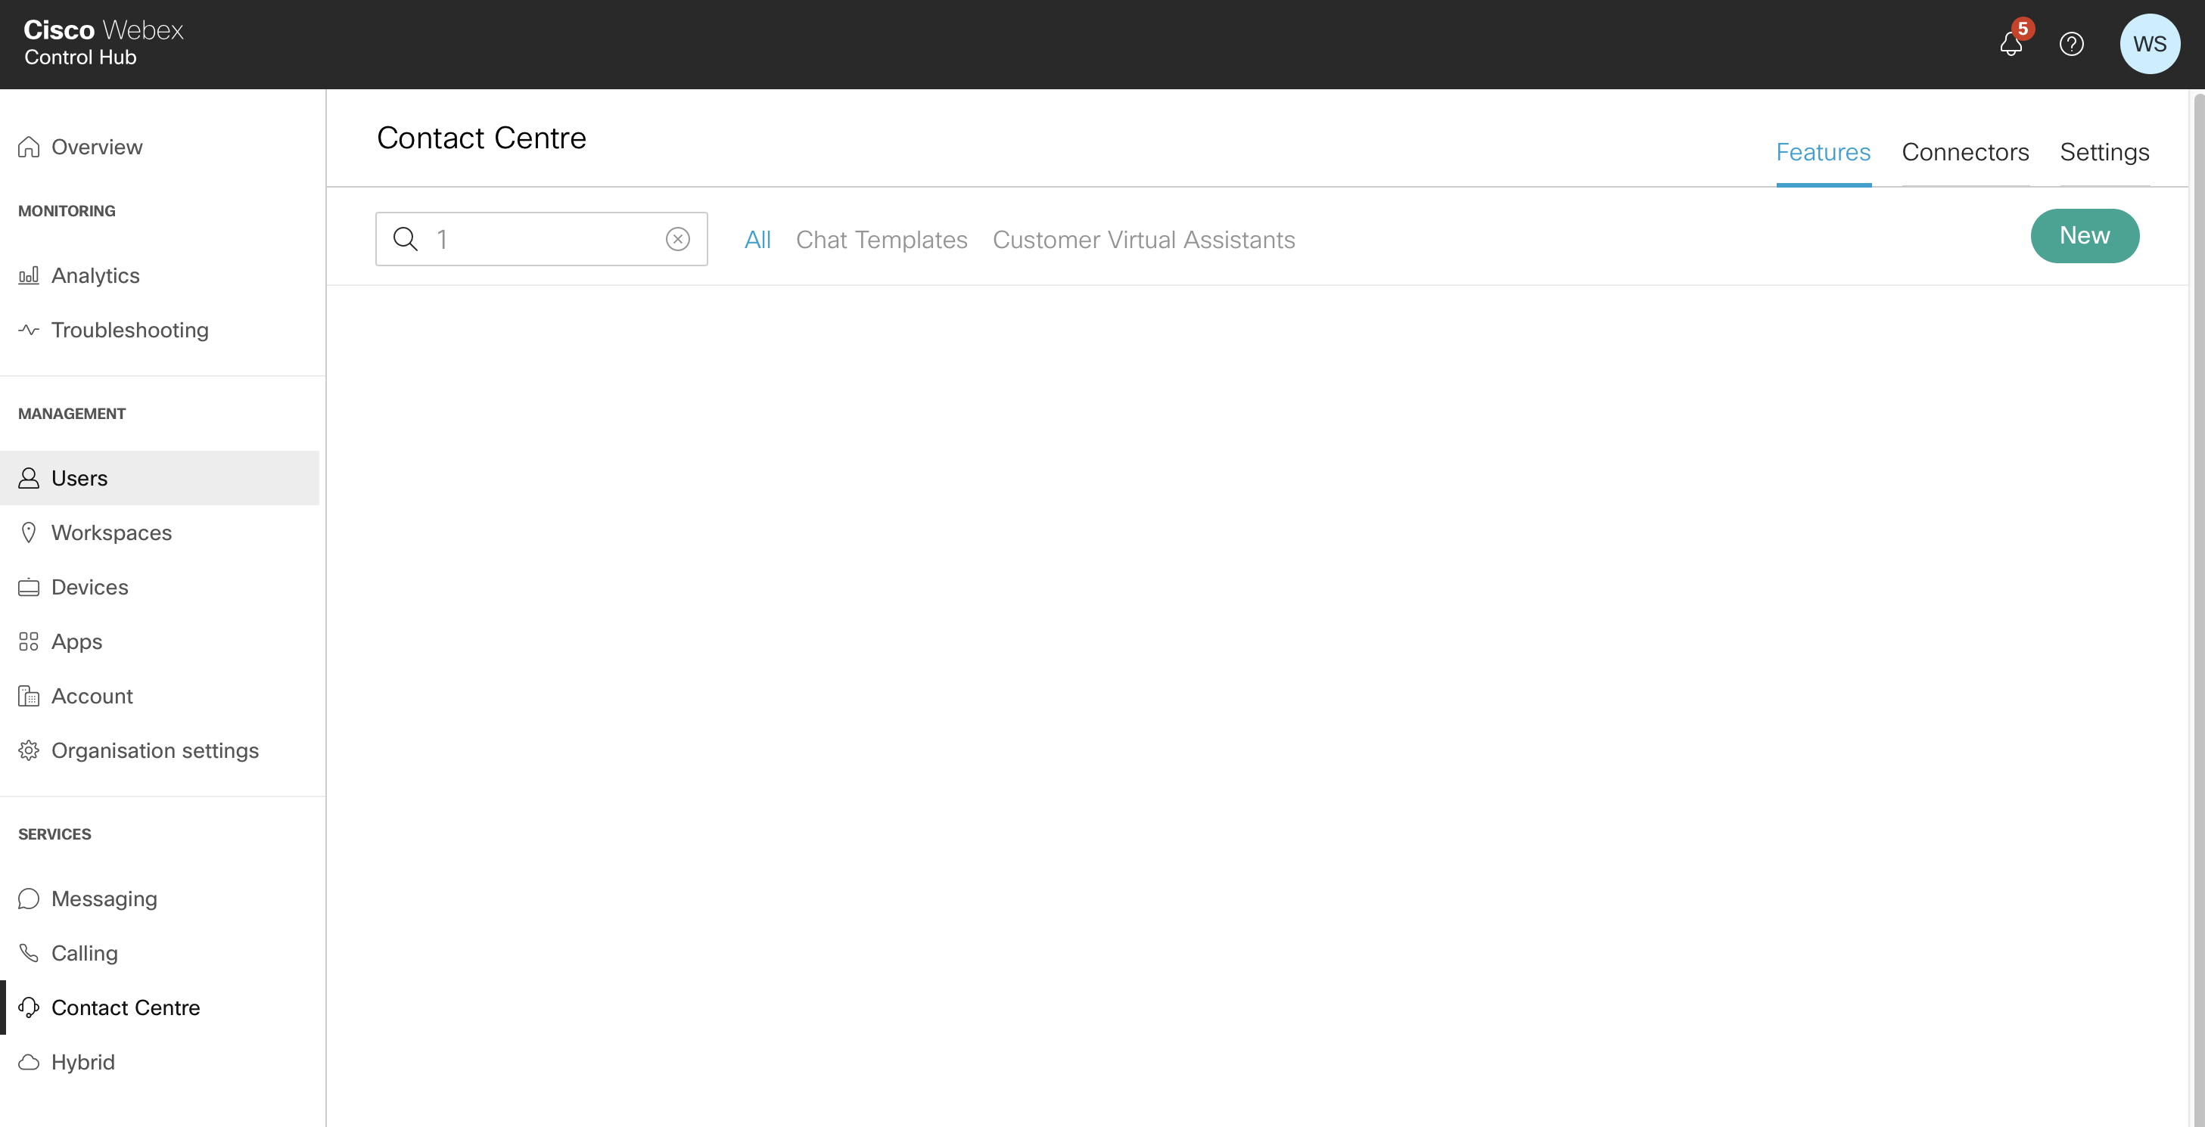
Create a Customer Virtual Assistant in Control Hub
https://admin.webex.com/login
2
1

Slide 3
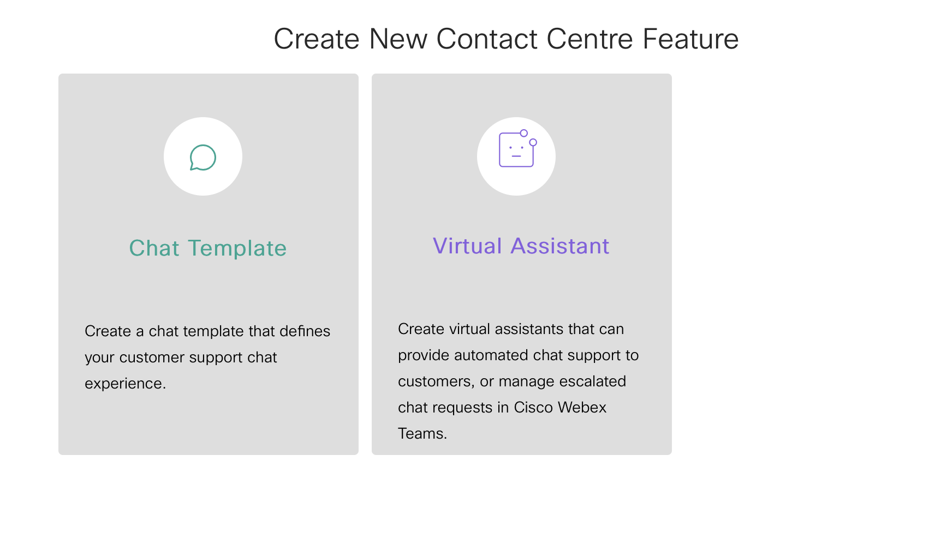
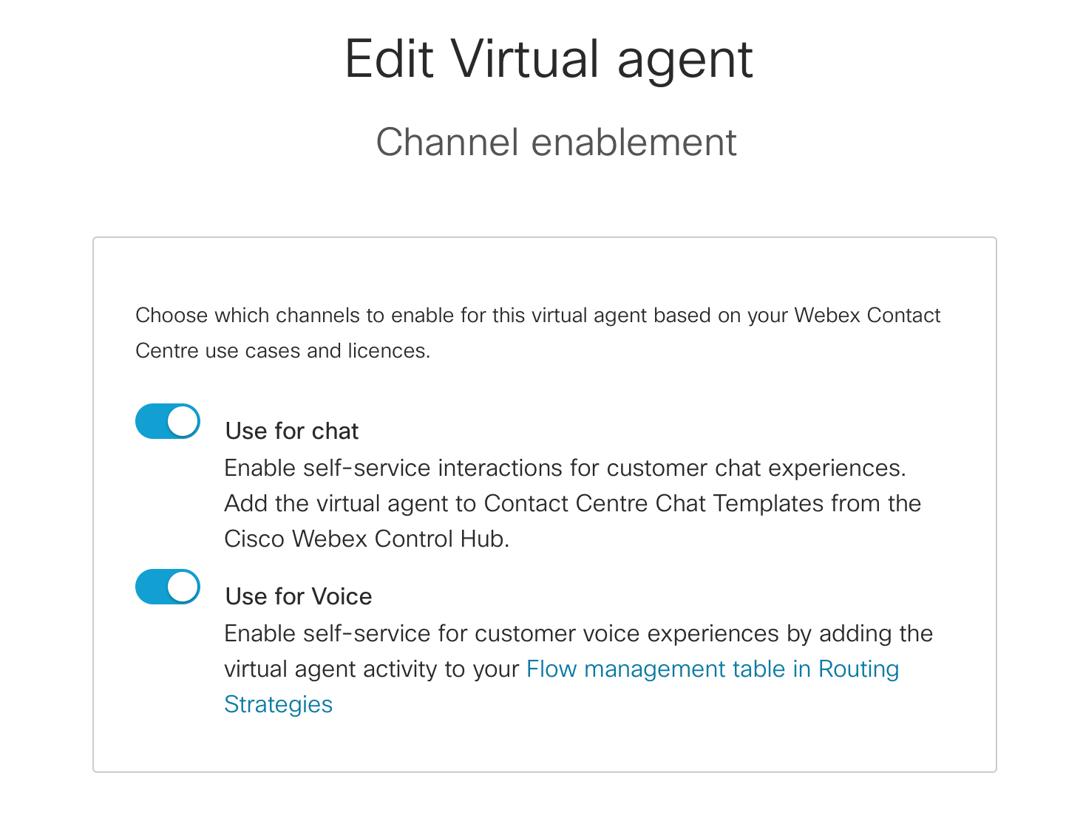

Create a CVA in Control Hub
1
2

Slide 4
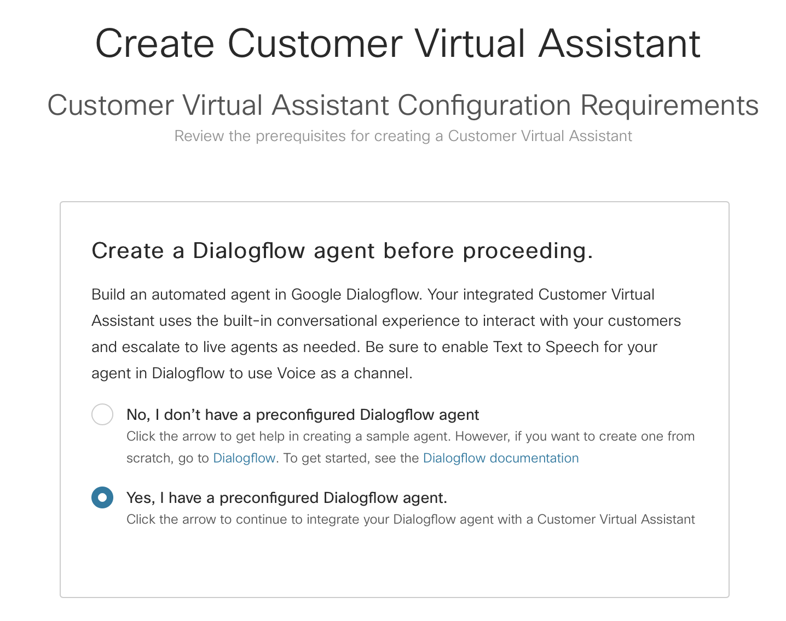
Create a CVA in Control Hub
Select ‘No’ to create a sample agent in Dialogflow from scratch
Select ‘Yes’ to use predefined intents to be integrated with your Dialogflow agent

Slide 5
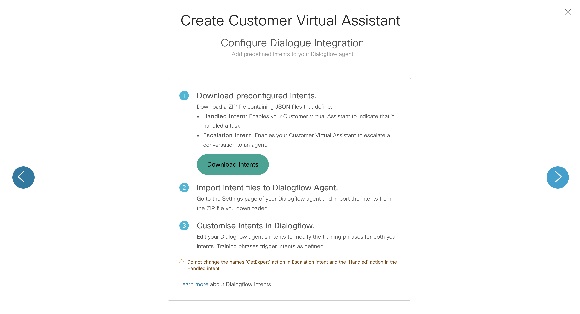
Create a CVA in Control Hub
1
2

Slide 6
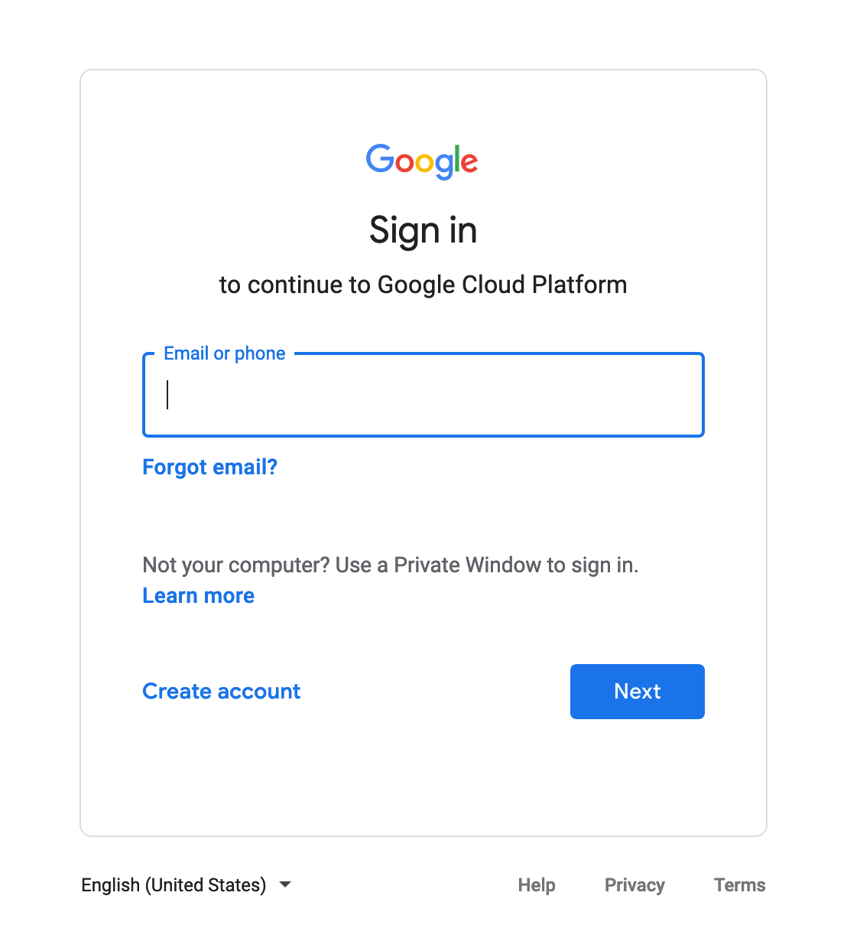
Sign Up with free Google account
https://console.cloud.google.com/

Slide 7
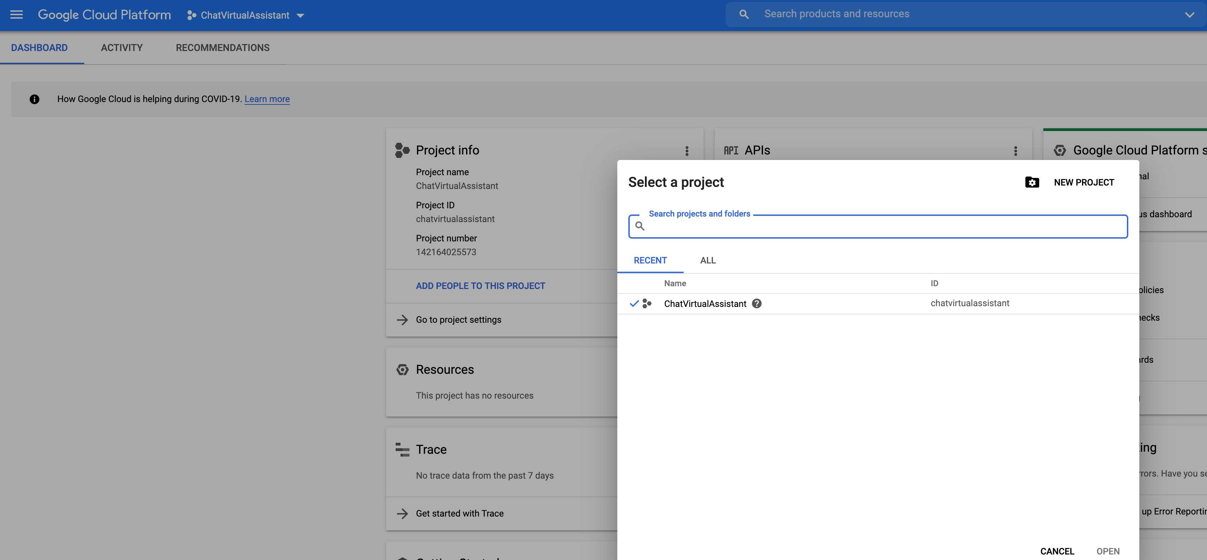
Create a new Project
1
2

Slide 8
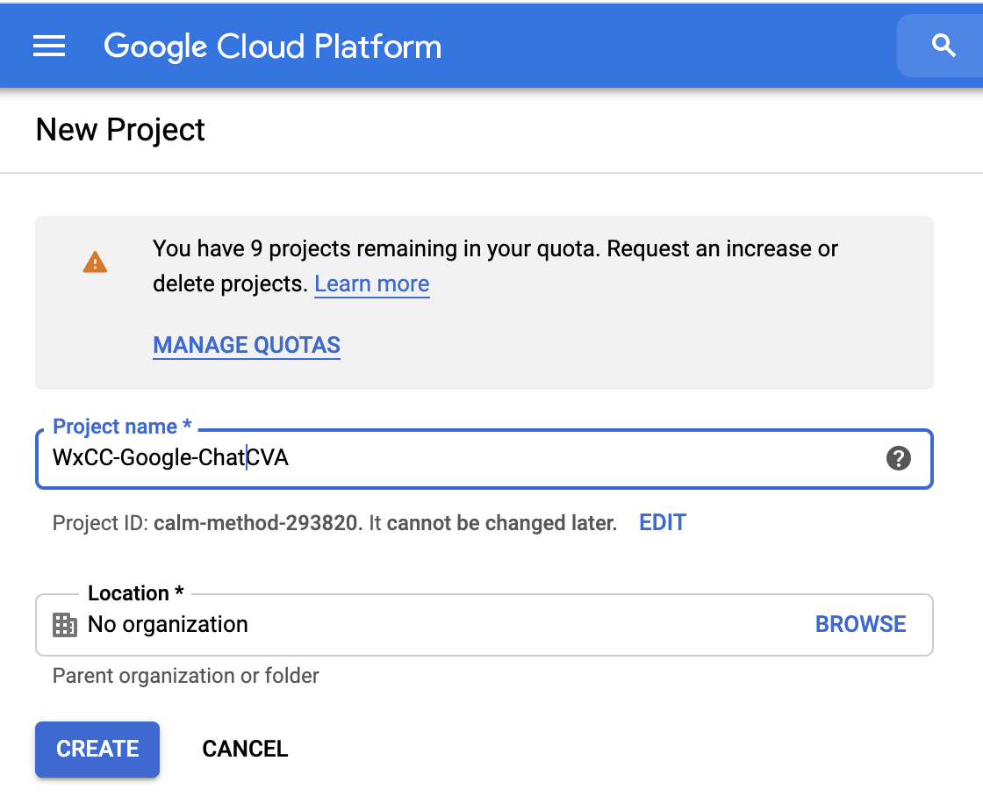
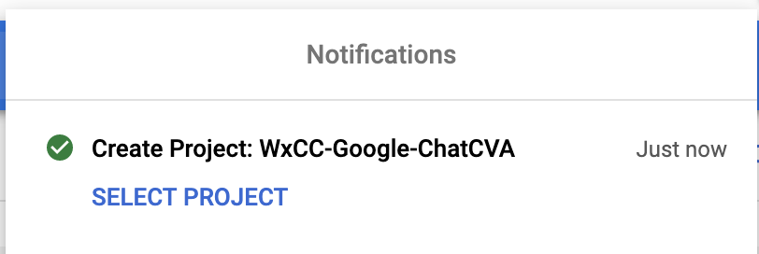
Create a new Project
1
3
2

Slide 9
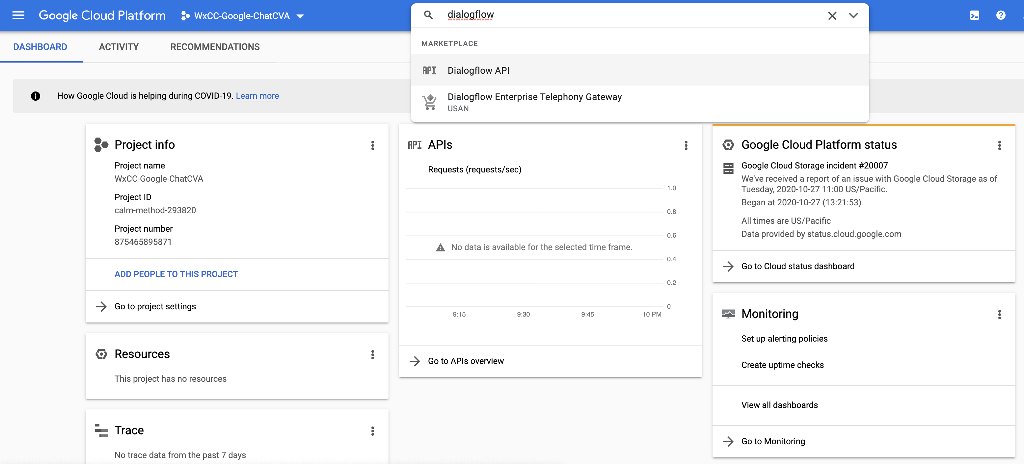
Enable Dialogflow API
1
2

Slide 10
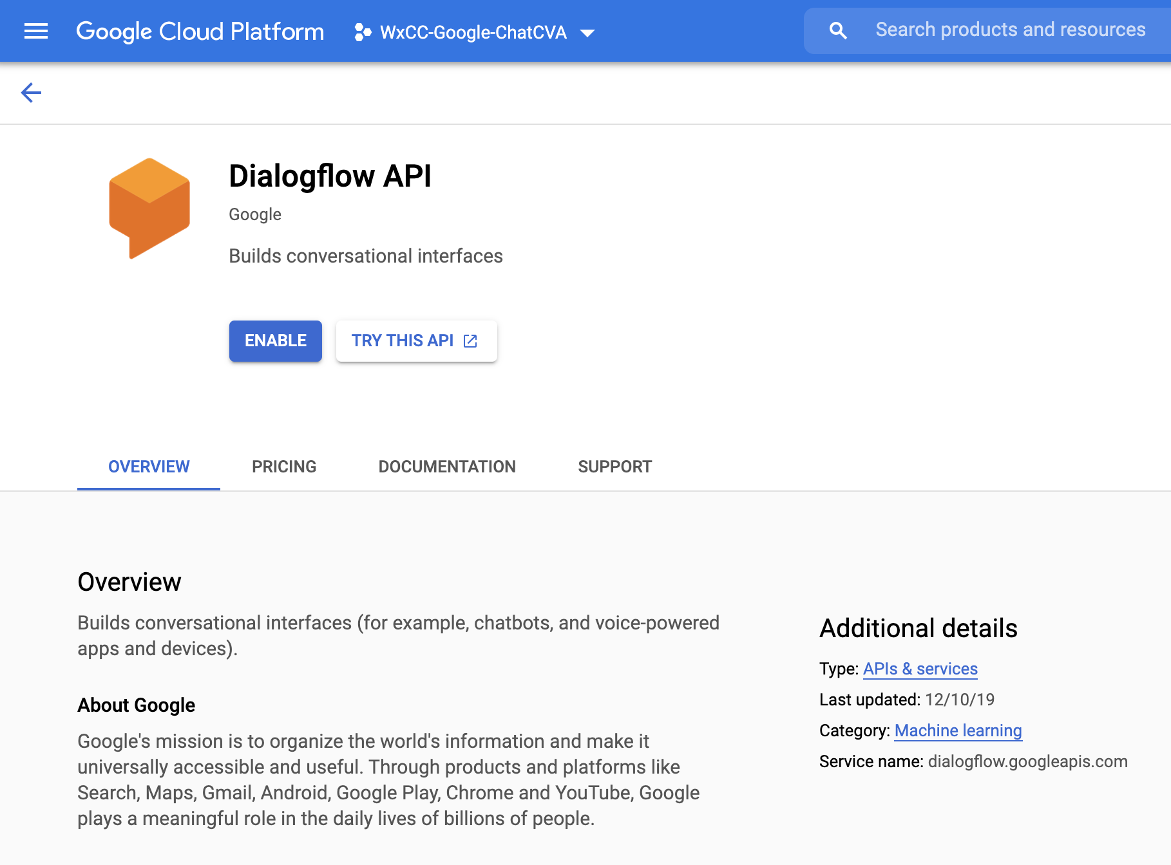
Enable Dialogflow API

Slide 11
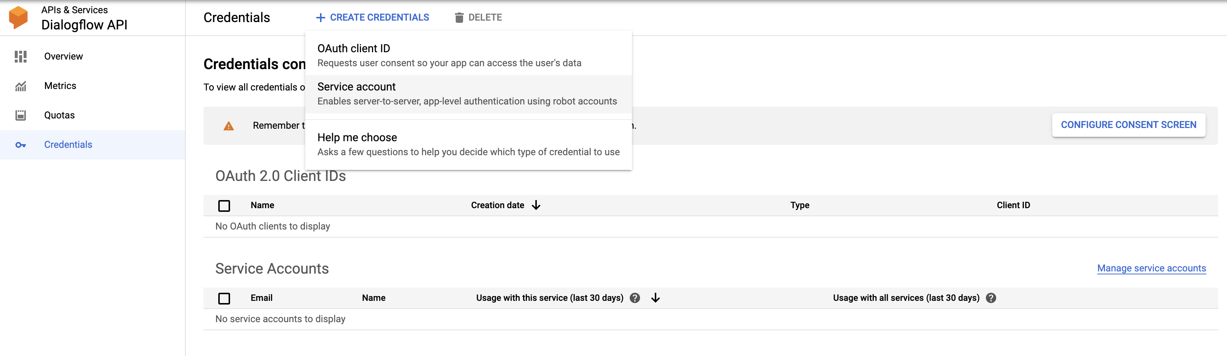
Create Private Key for Dialogflow API
2
3
1

Slide 12
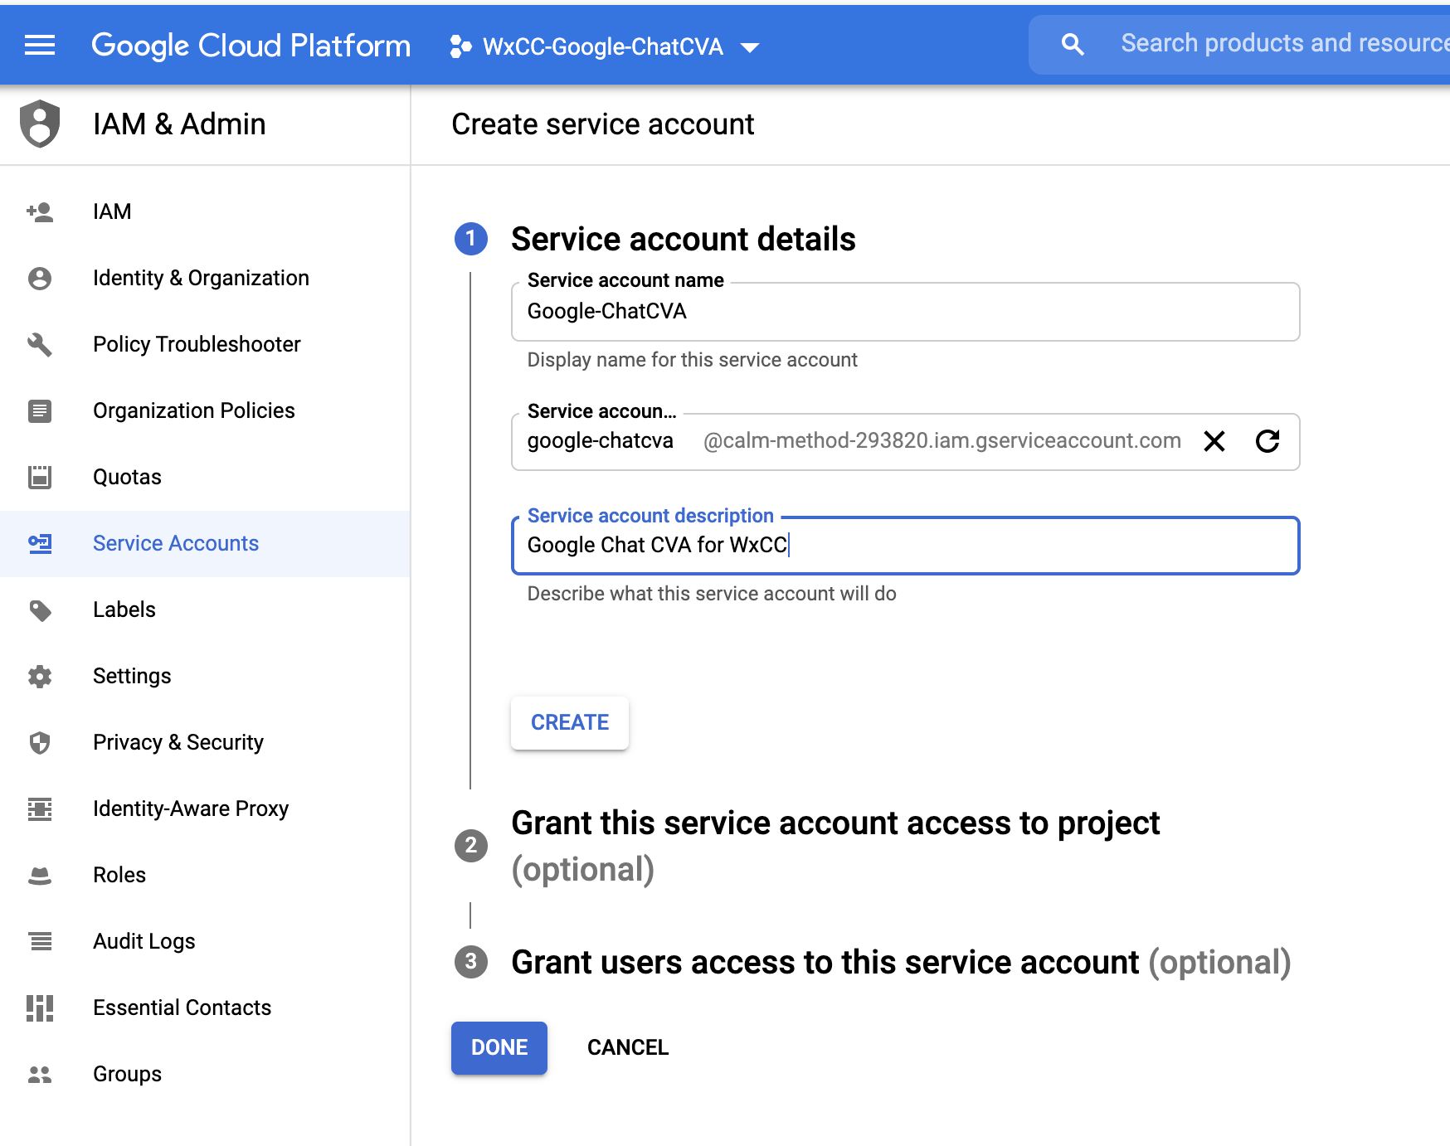
Create Private Key for Dialogflow API
1
2
3

Slide 13
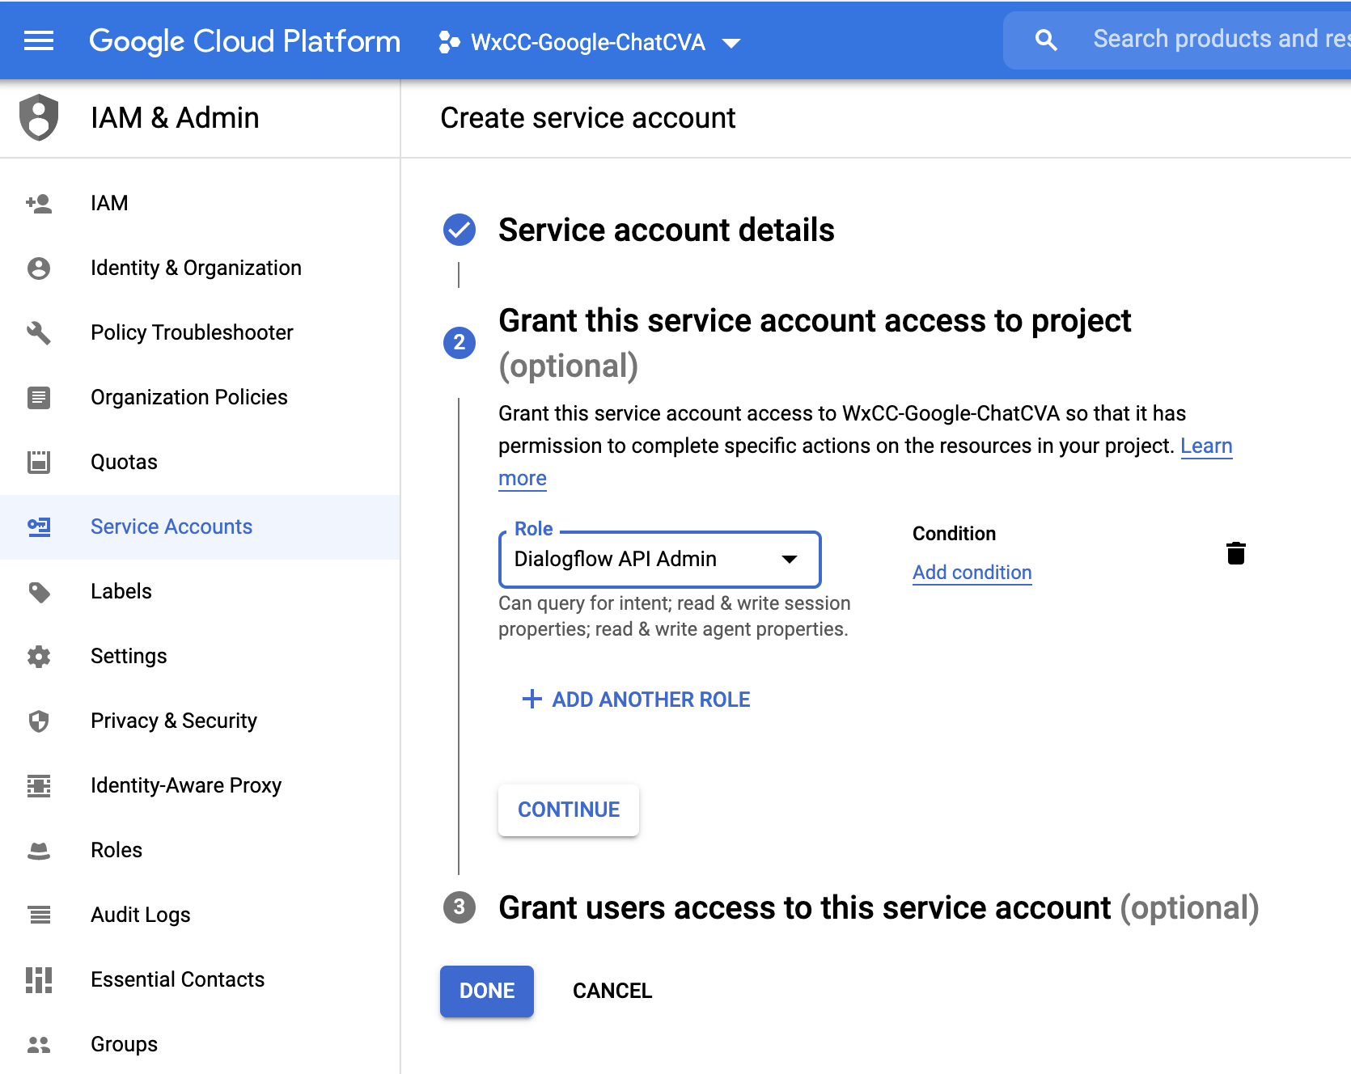
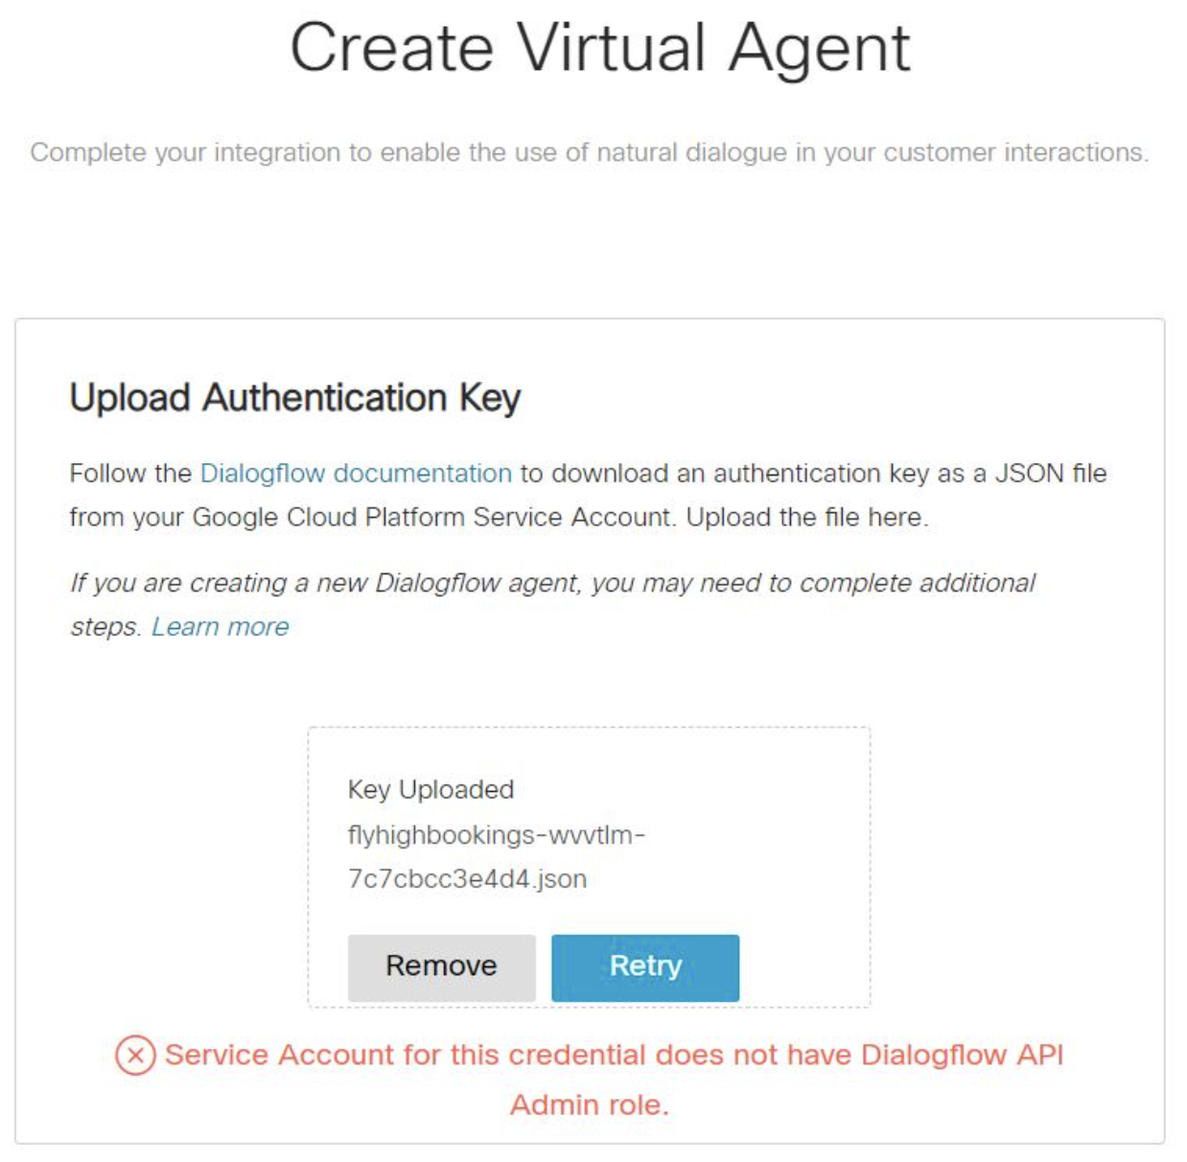
Create Private Key for Dialogflow API
Note: If role was not defined as “Dialogflow API Admin”
1
2

Slide 14
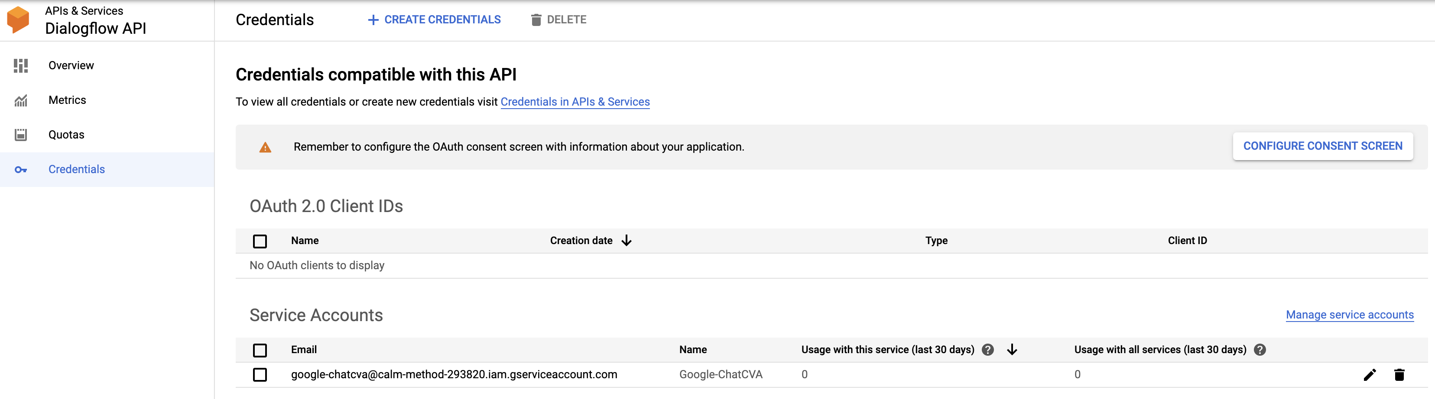
Create Private Key for Dialogflow API

Slide 15
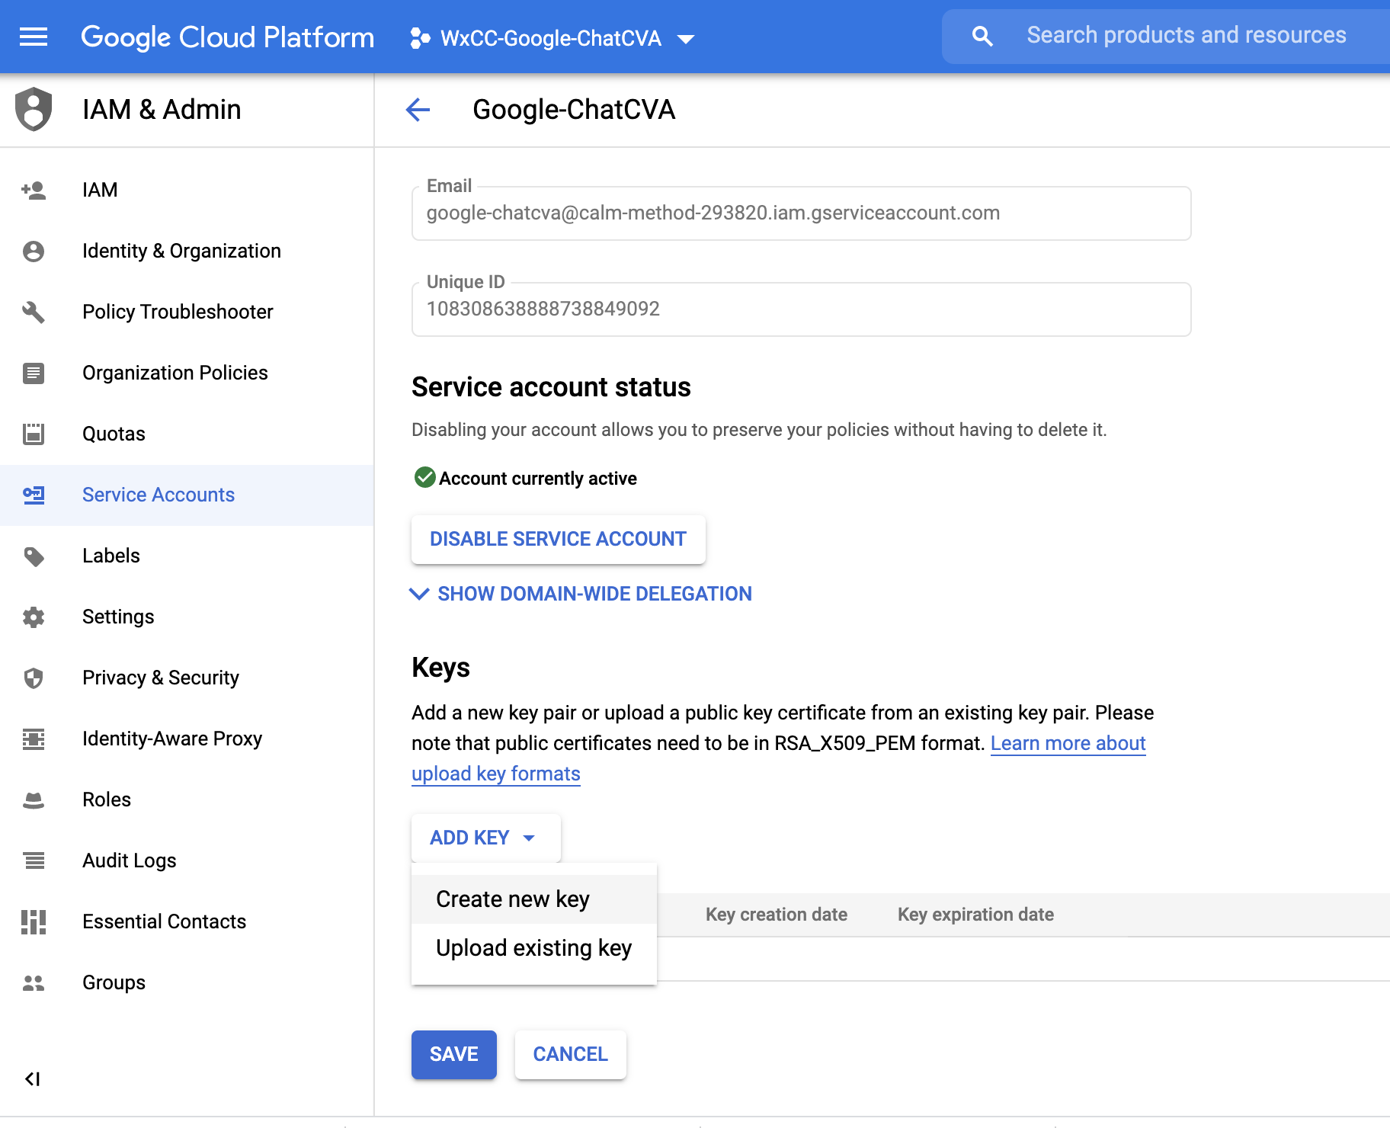
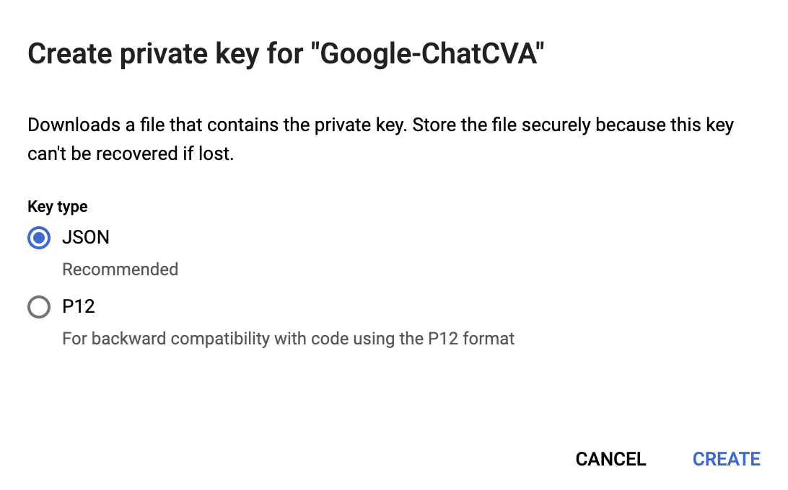
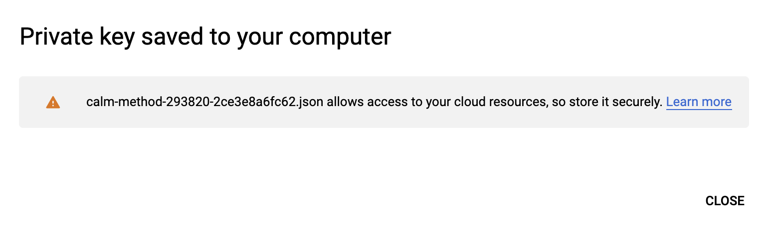
Create Private Key for Dialogflow API

Slide 16
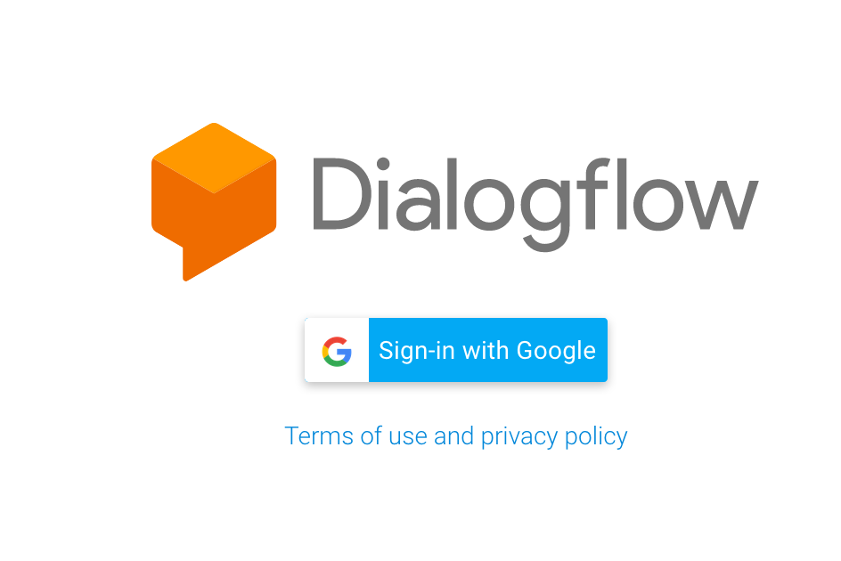
Go to Dialogflow ES
https://dialogflow.cloud.google.com/

Slide 17
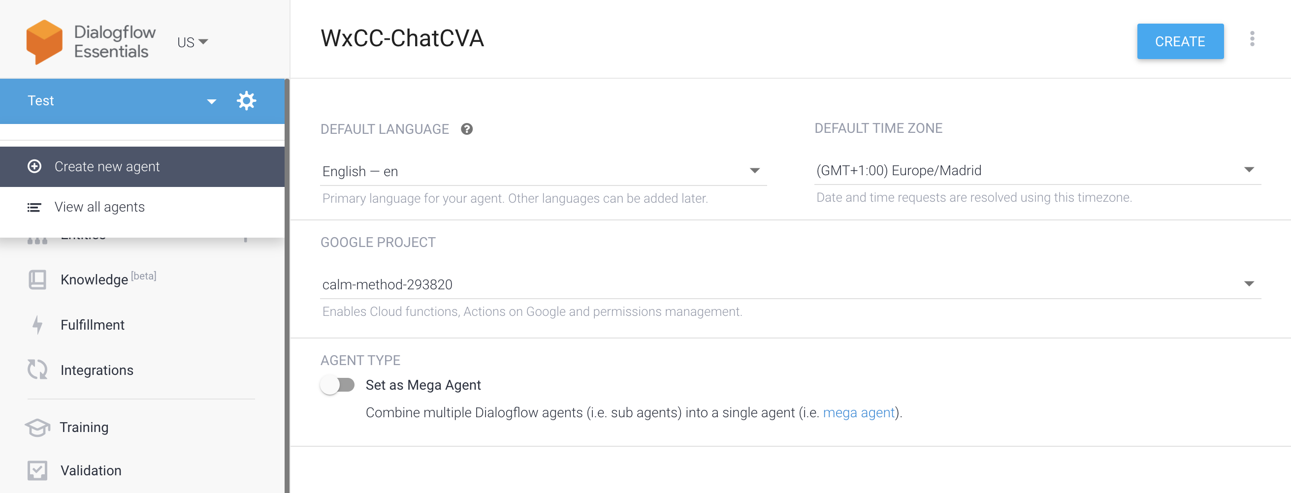
Create a new Agent
2
4
1
3

Slide 18
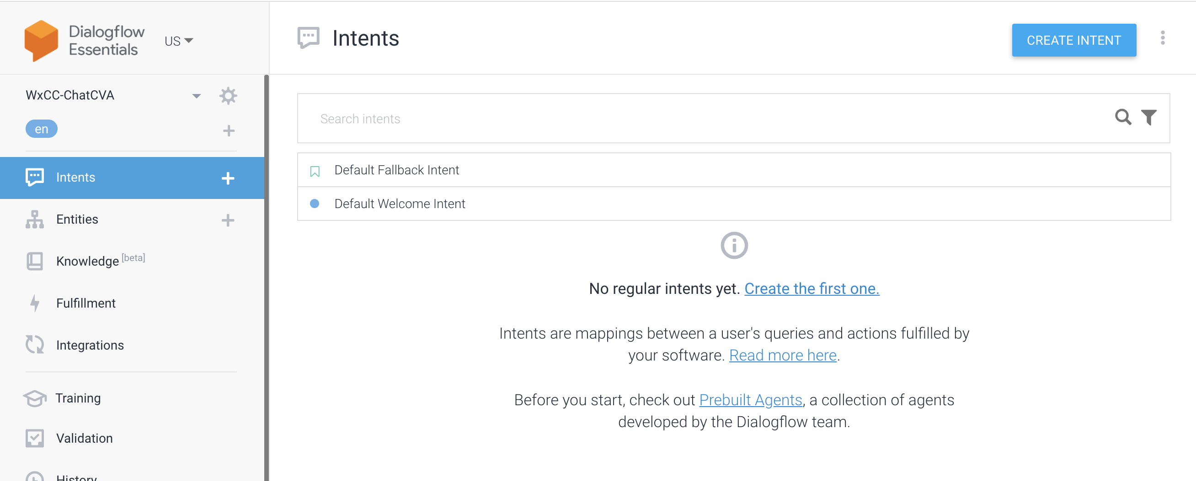
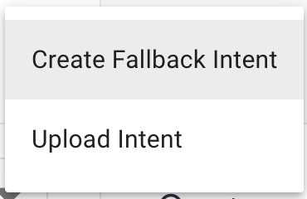
Upload intent files from CH
2
3
1

Slide 19
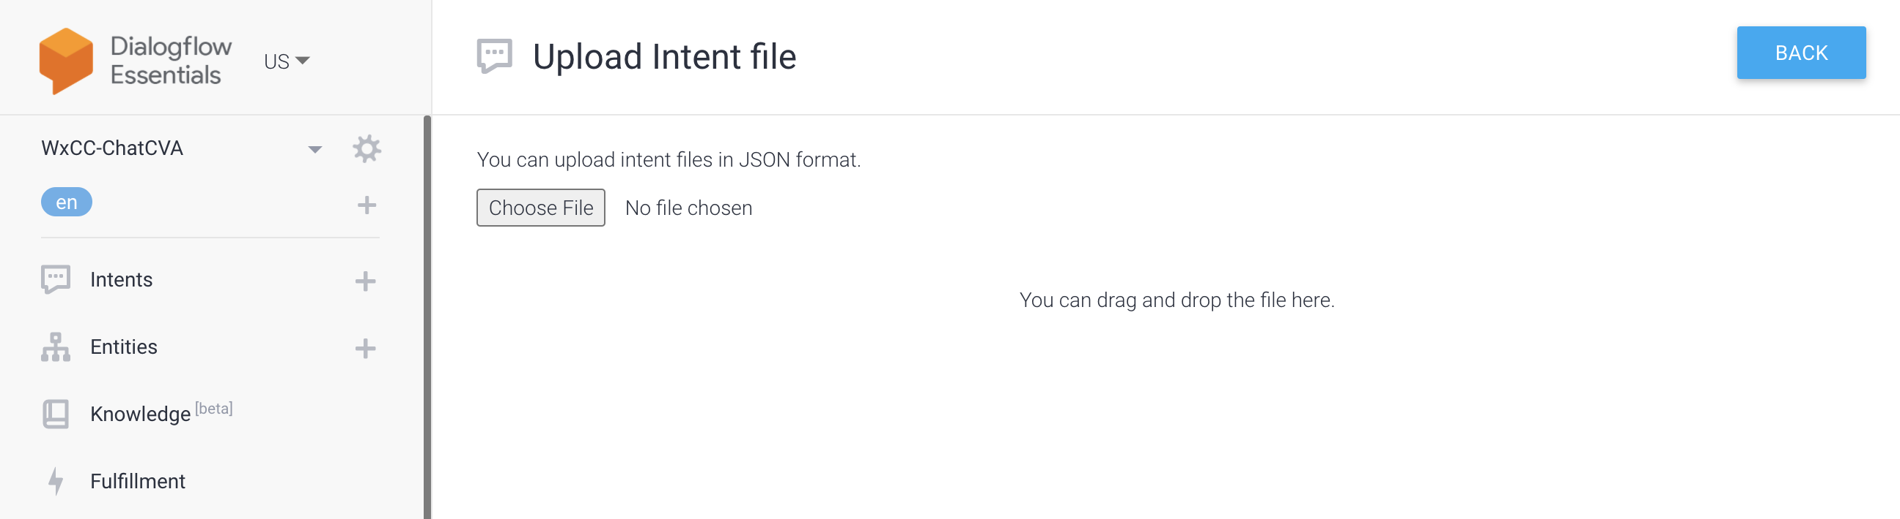
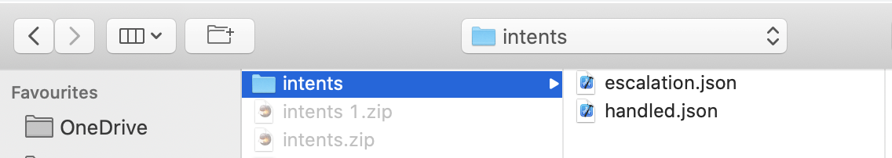
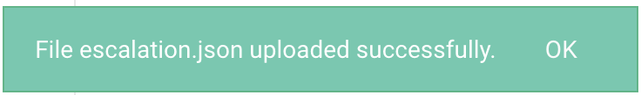

Upload intent files from CH

Slide 20
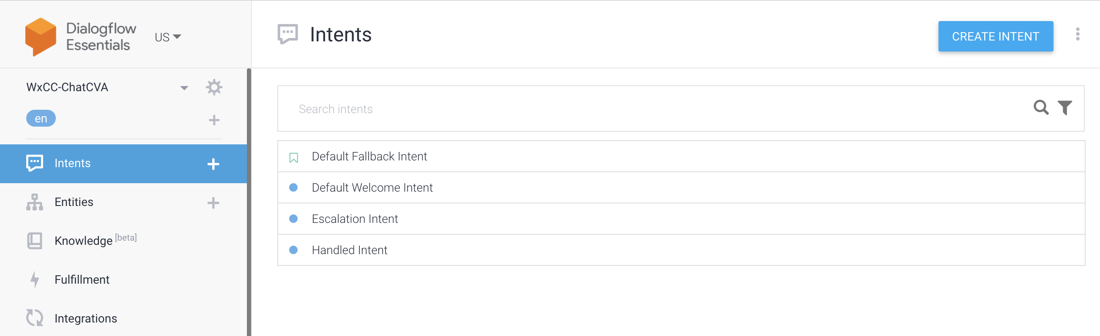
Upload intent files from CH

Slide 21
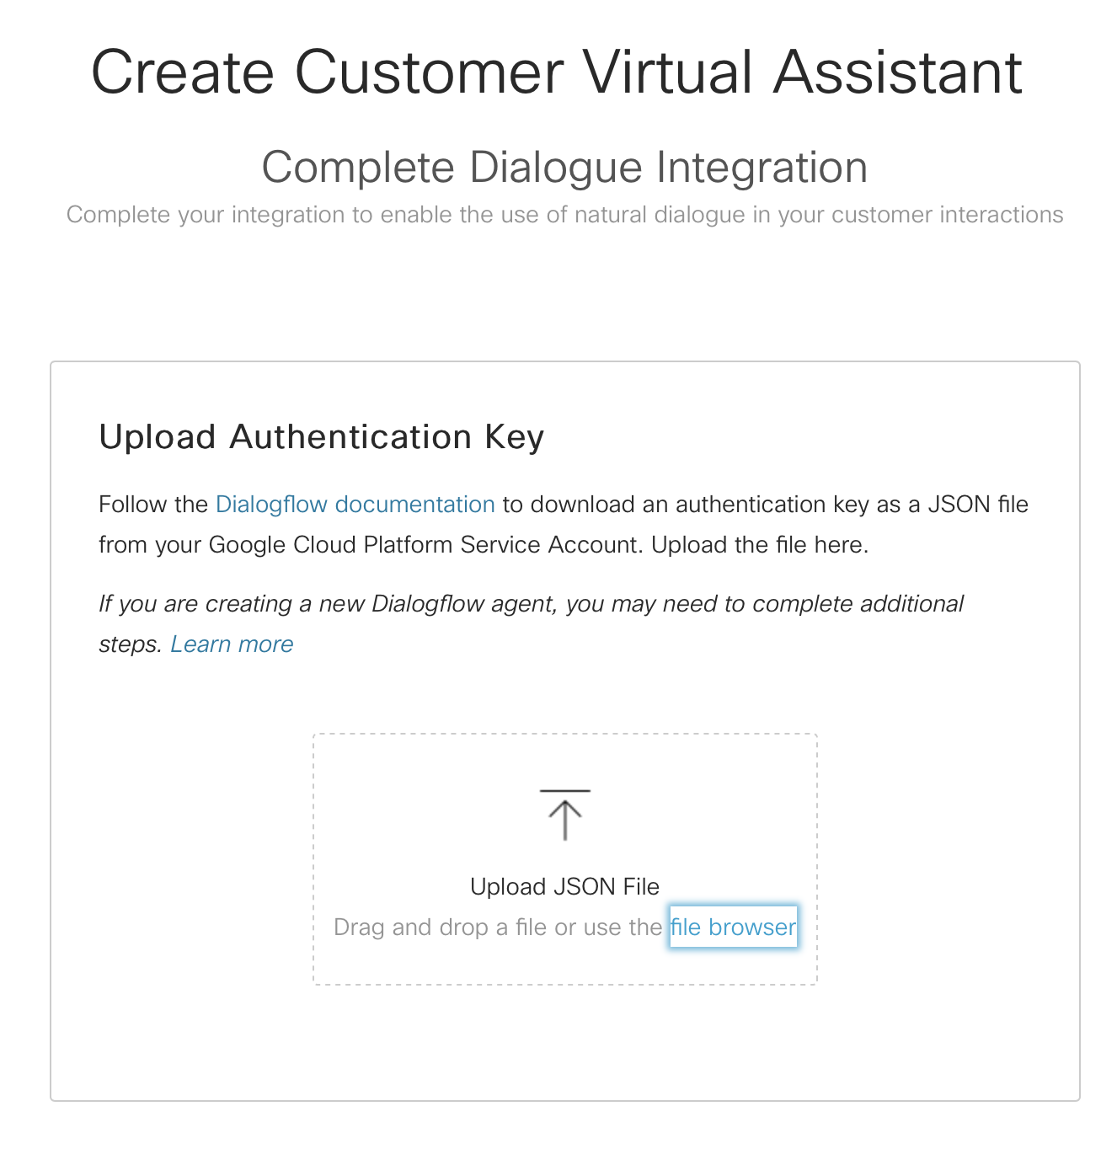
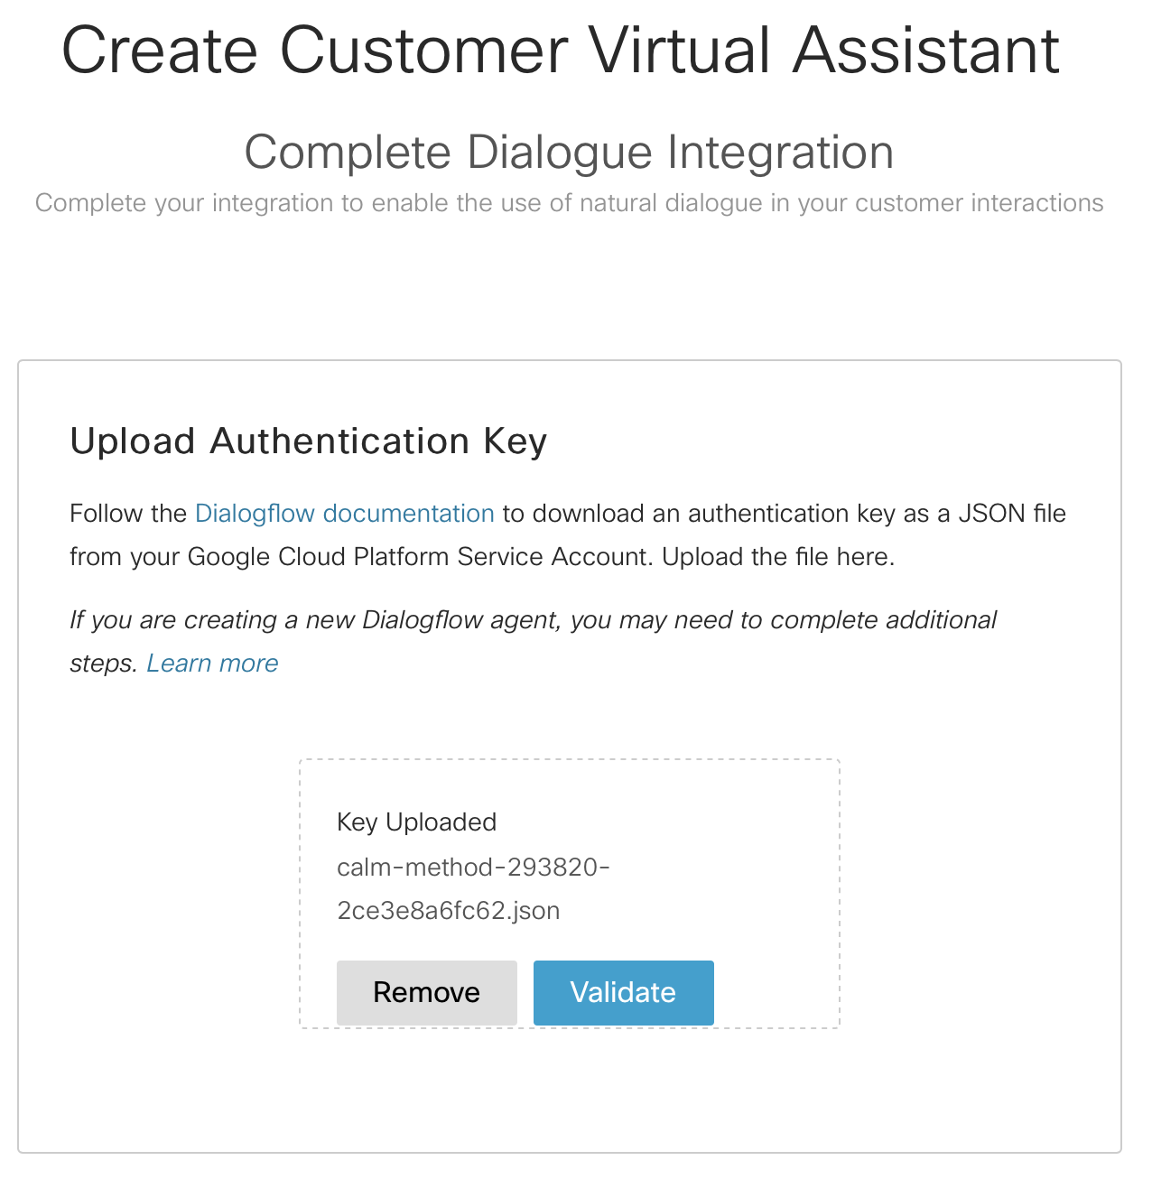
Complete Dialogue Integration in Control Hub

Slide 22
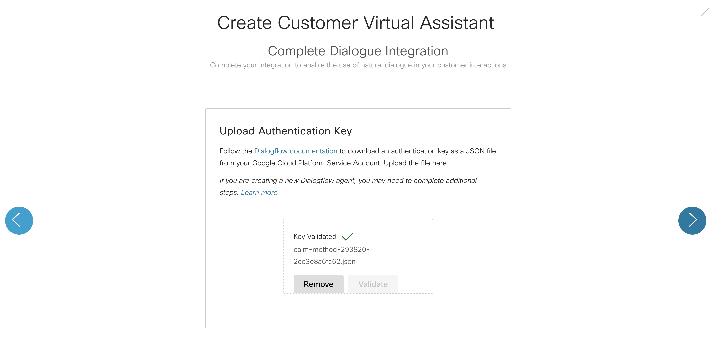
Complete Dialogue Integration in Control Hub

Slide 23
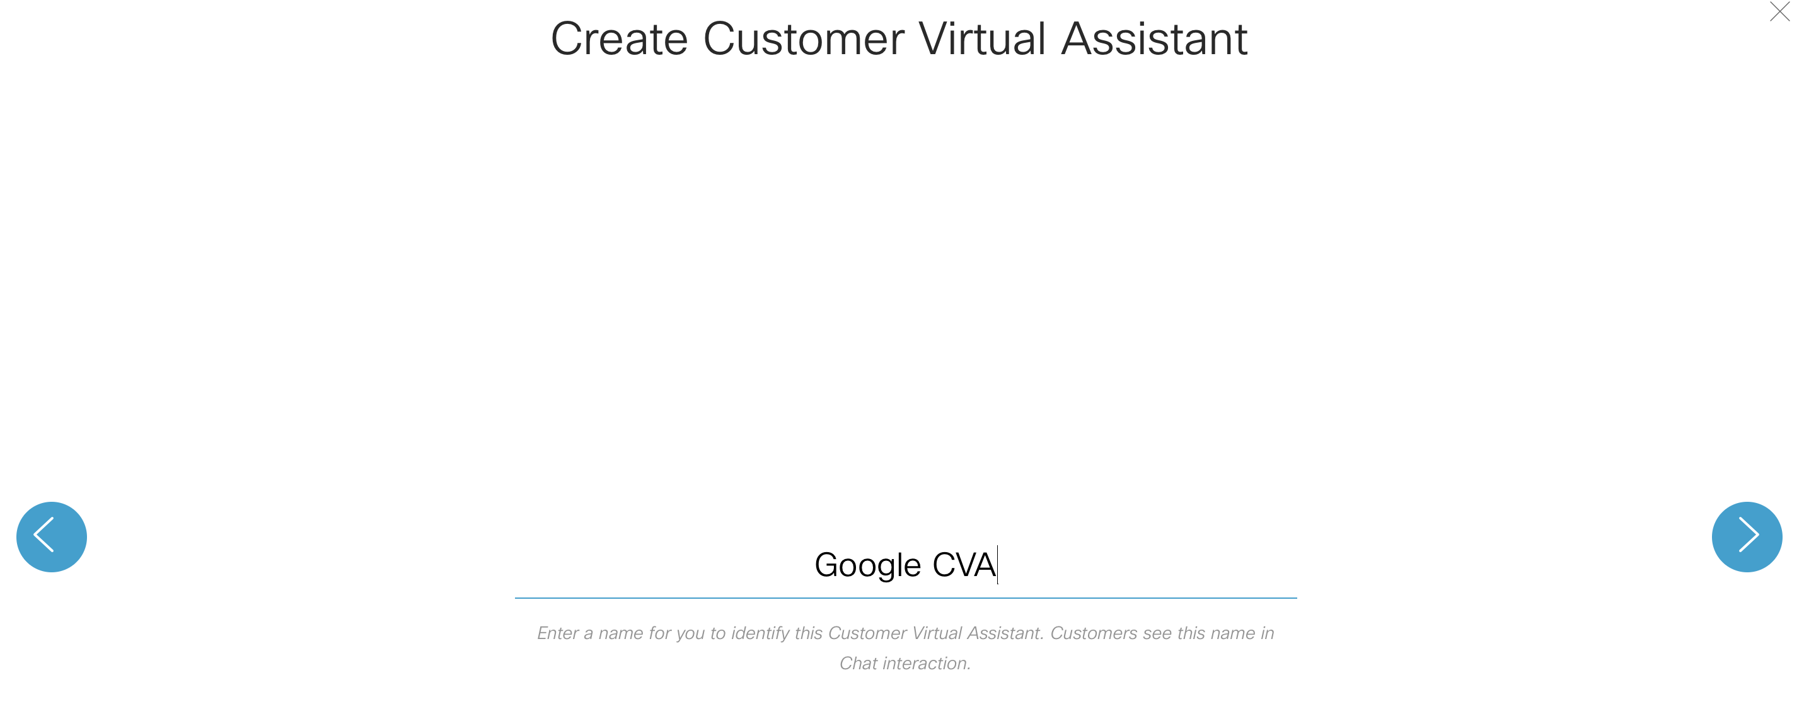
Complete Dialogue Integration in Control Hub

Slide 24
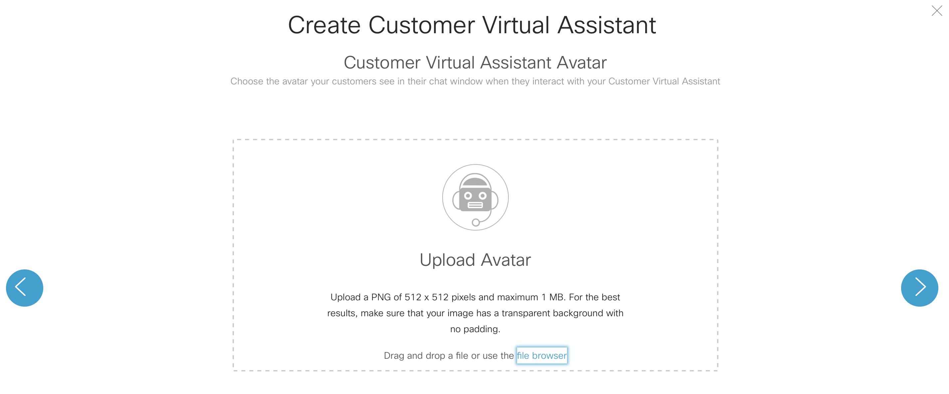
Complete Dialogue Integration in Control Hub

Slide 25
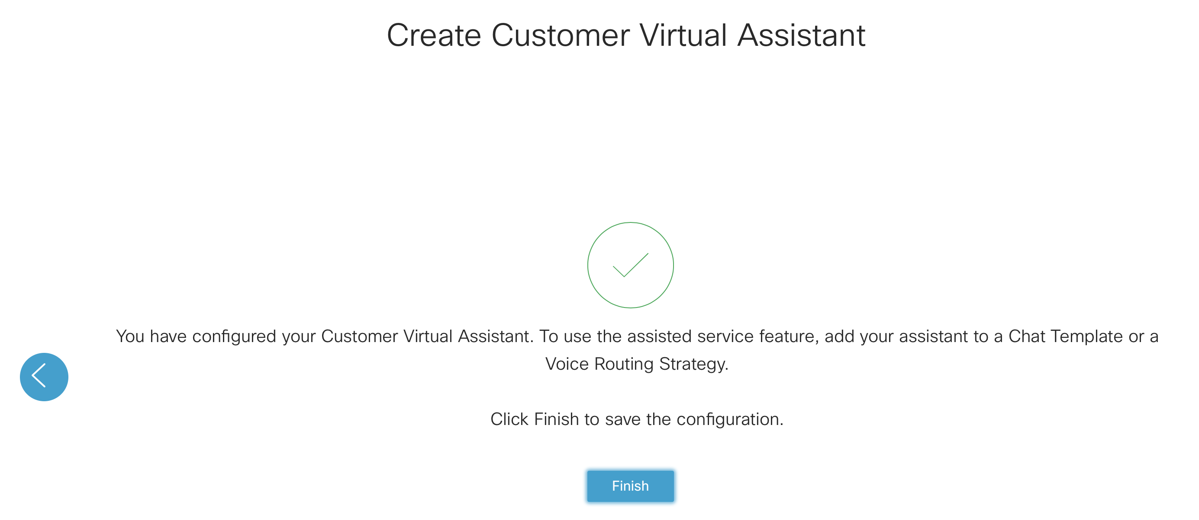
Complete Dialogue Integration in Control Hub

Slide 26
Chat Configuration

Slide 27
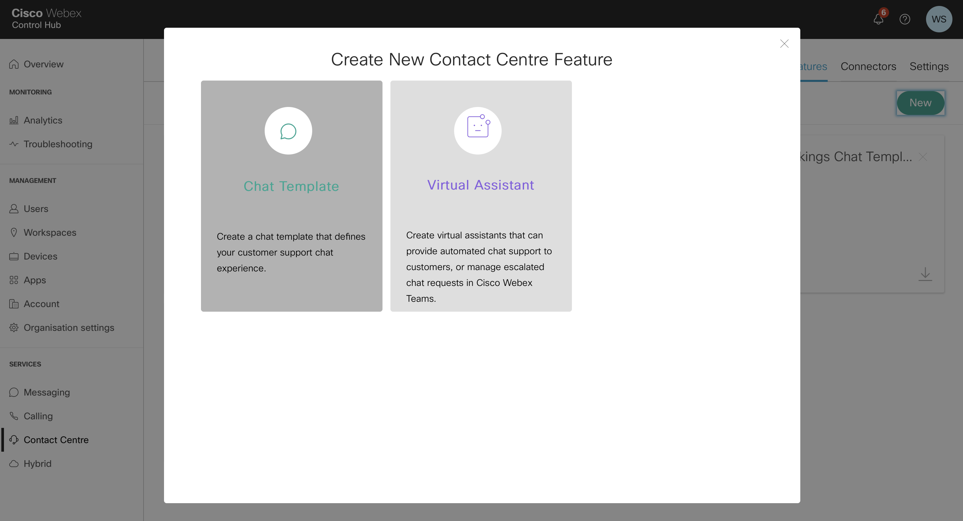
Create a chat template with CVA

Slide 28
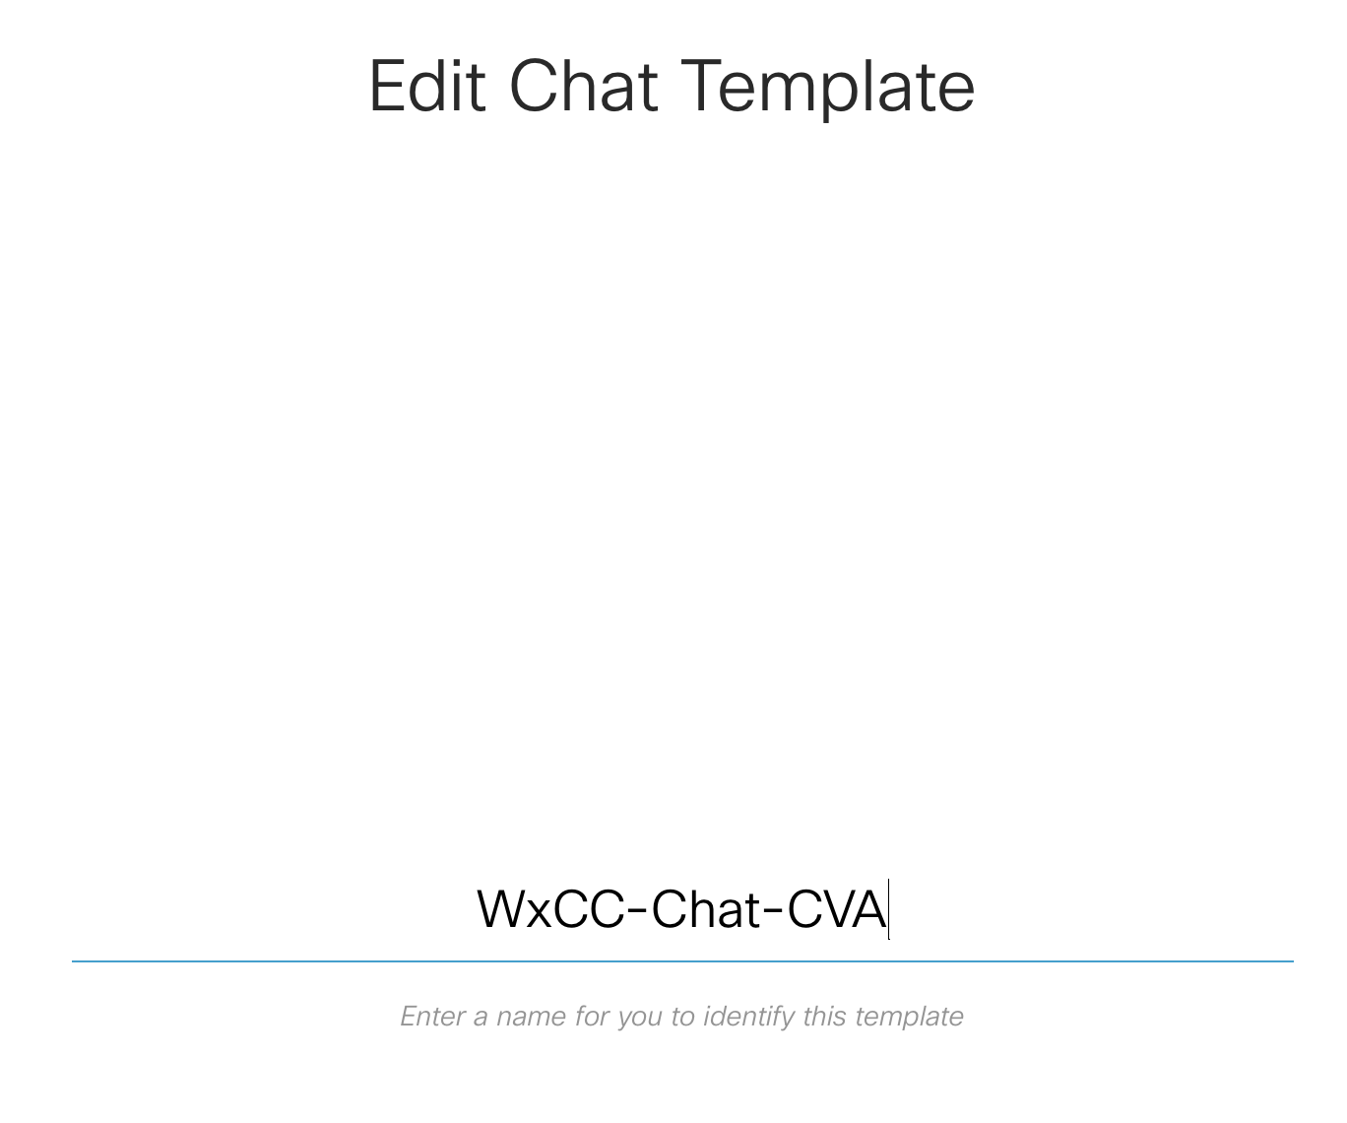
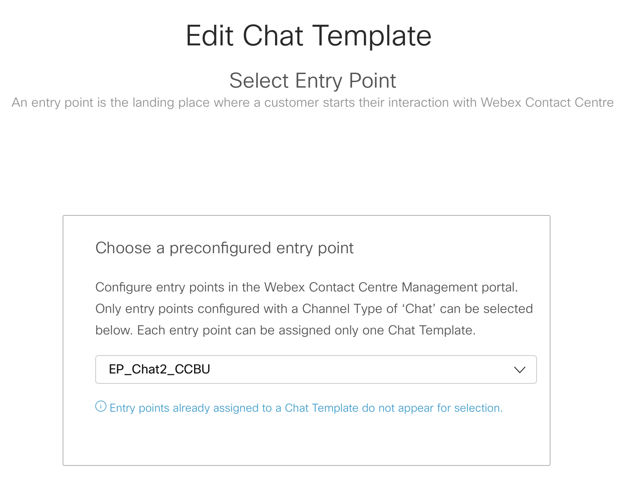
Create a chat template with CVA

Slide 29
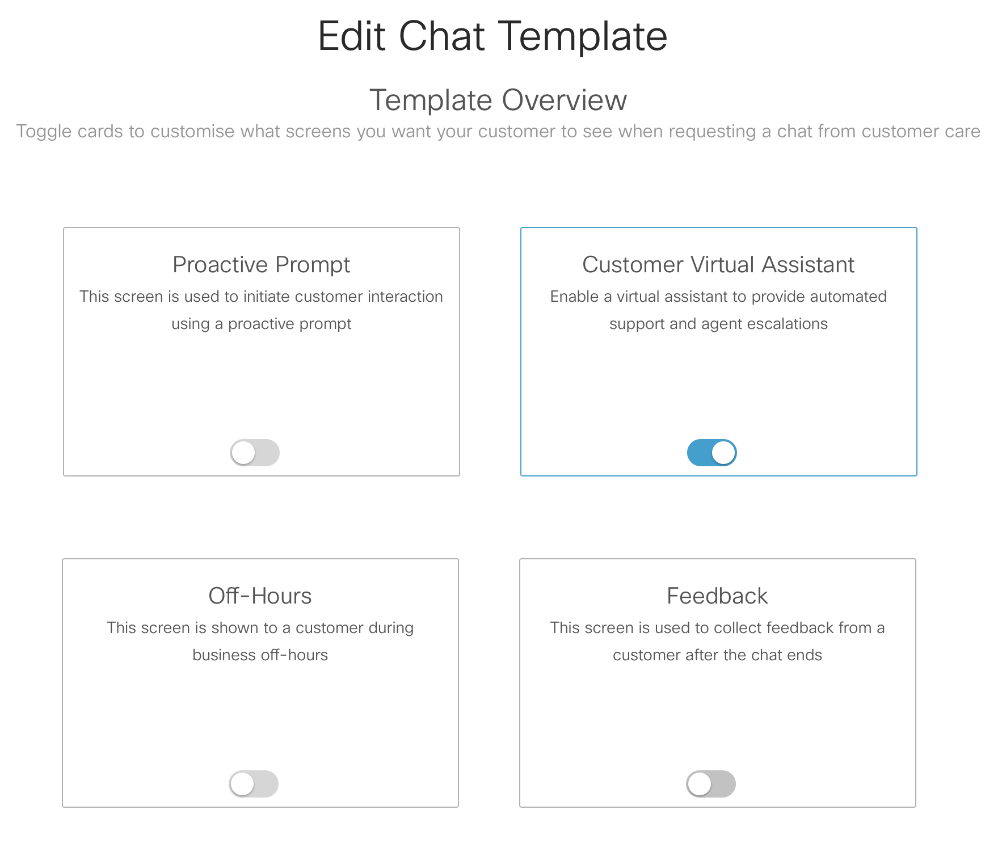
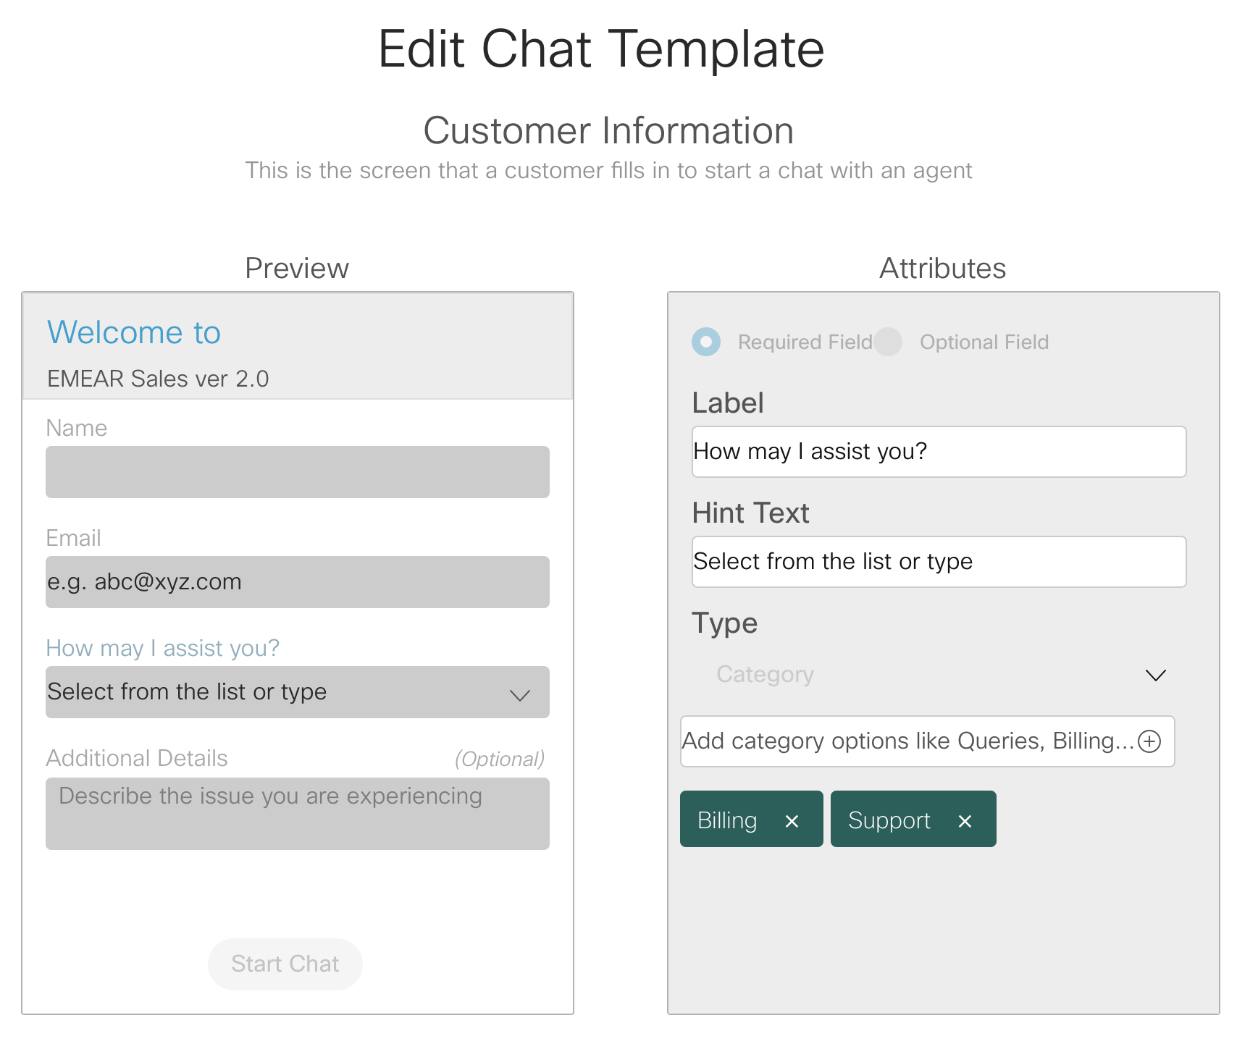
Create a chat template with CVA

Slide 30
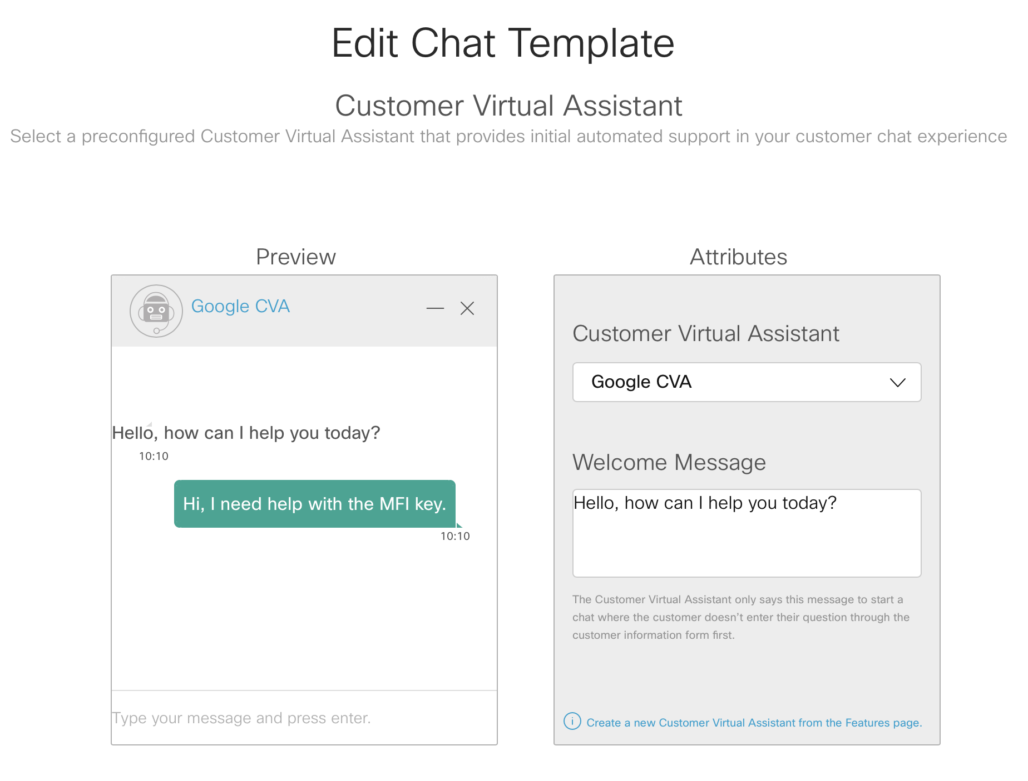
Create a chat template with CVA

Slide 31
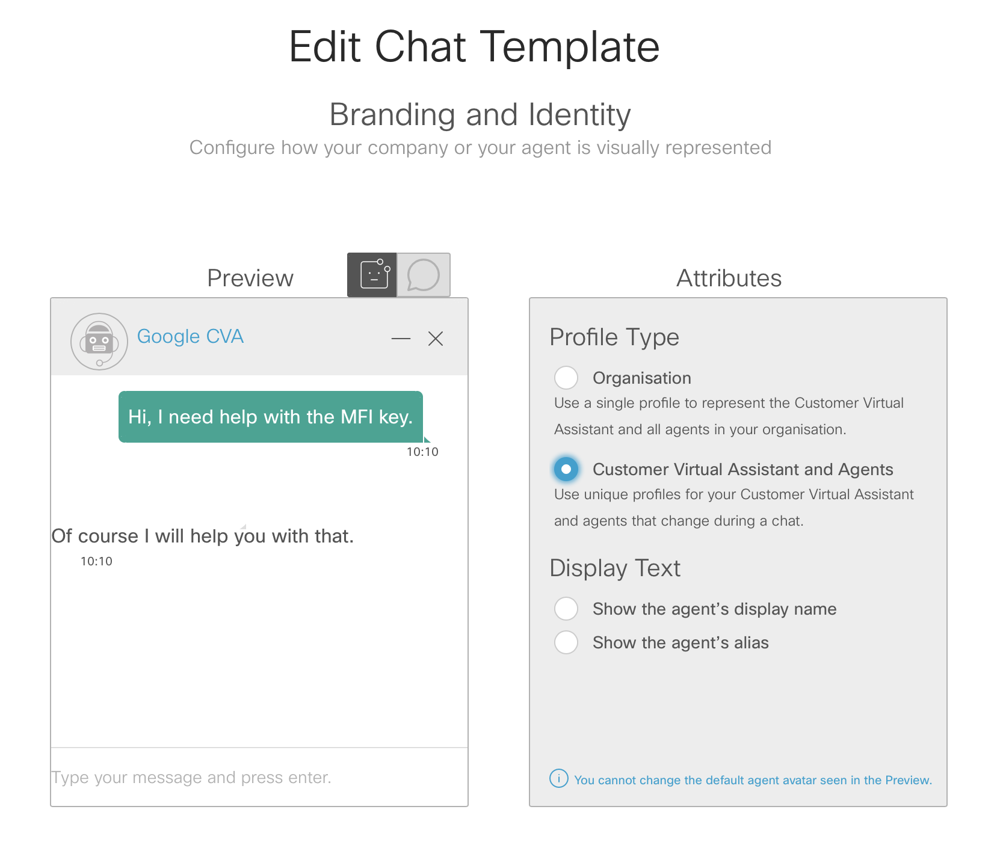
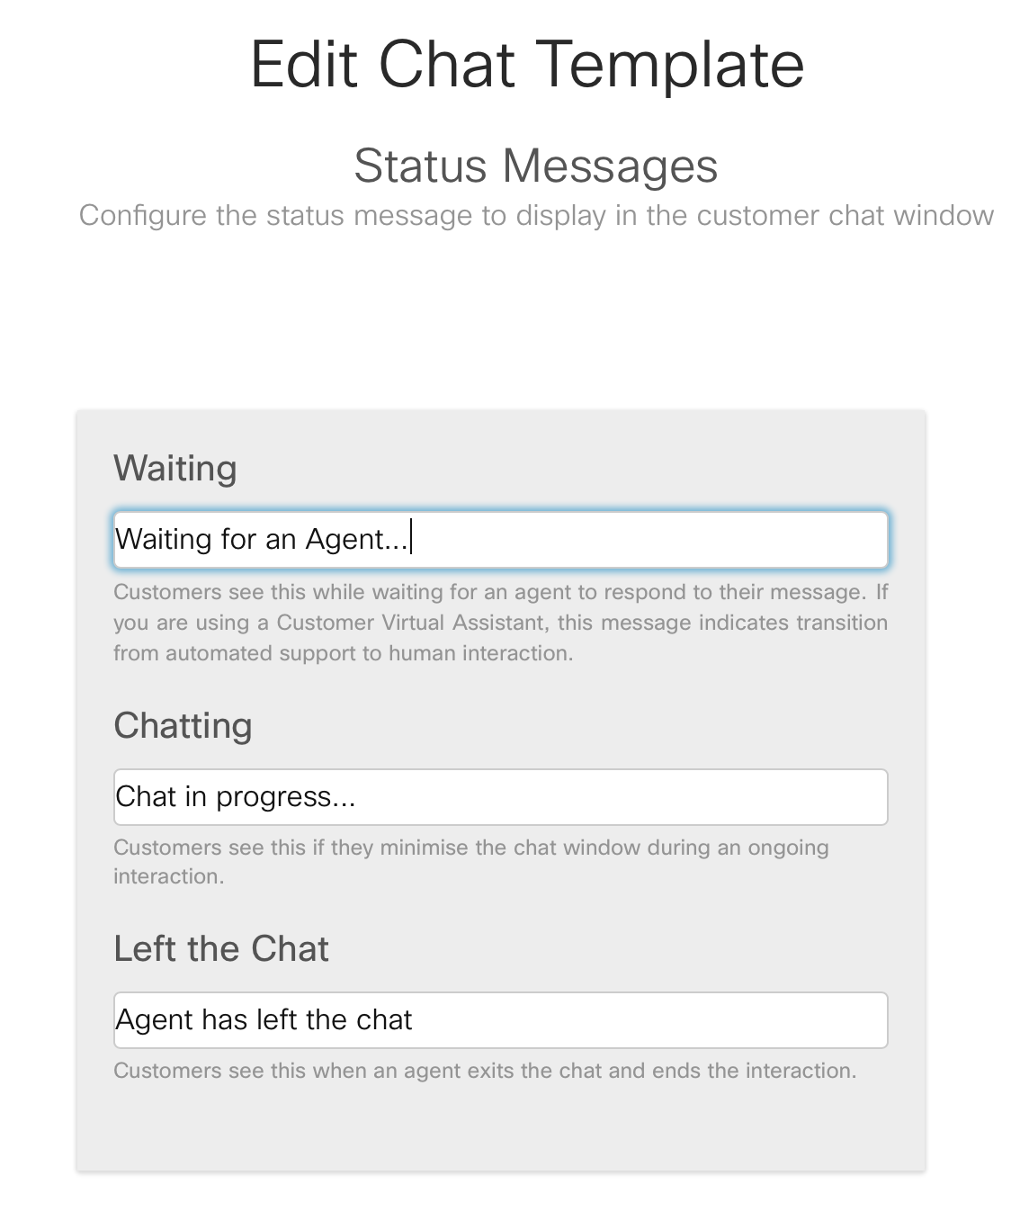
Create a chat template with CVA

Slide 32
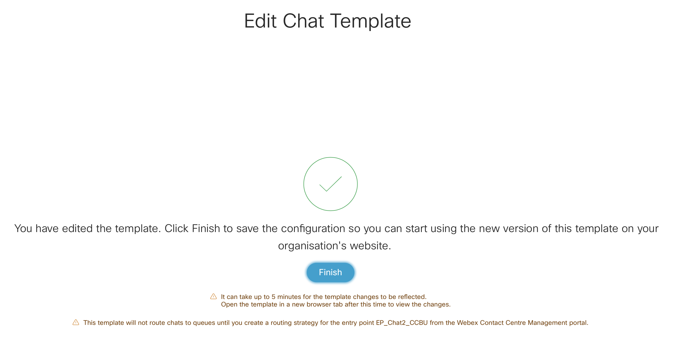
Create a chat template with CVA

Slide 33
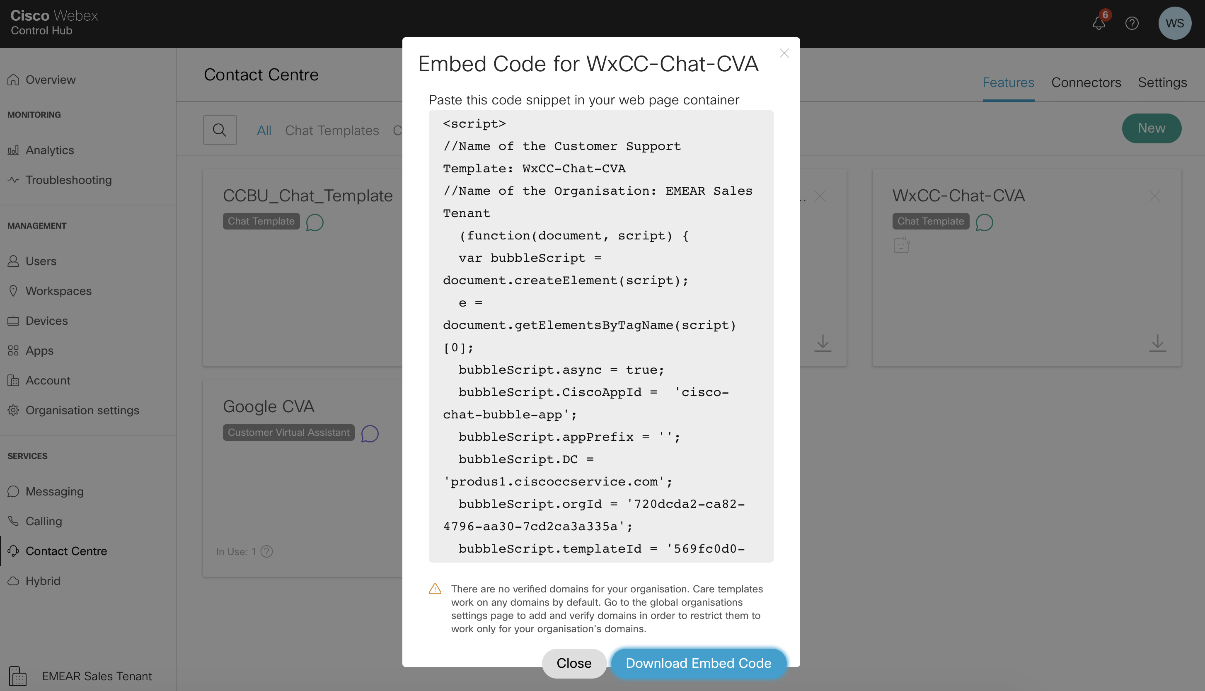
Create a chat template with CVA

Slide 34
Voice Configuration (with script Flow)

Slide 35
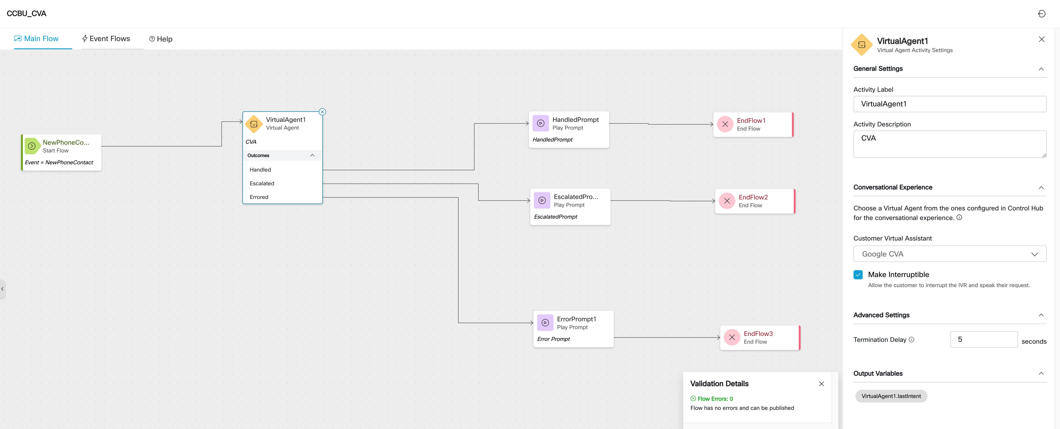
Create Flow with CVA

